Slide 1

Data Analytics Using Python Dr. Ziping Liu
Chapter 1 Python Programming Language Review

Slide 2
https://he.kendallhunt.com/product/data-analytics-using-python
Chapter 1 Python Programming Language Review

Slide 3
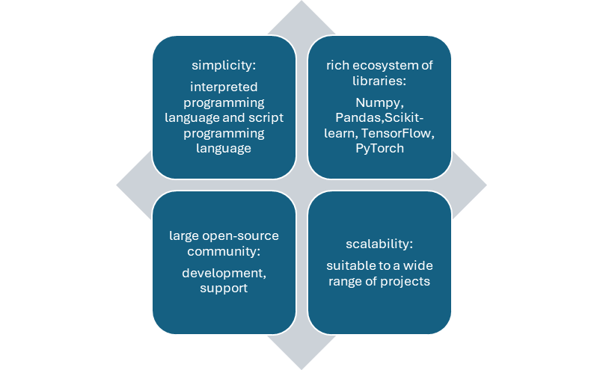
Python Advantages
Popular programming language data science and artificial intelligence
offers the advantages of simplicity, a rich ecosystem of libraries, a large open-source community, and scalability
Unlike compiled languages such as C++,Java
is an interpreted language, doesn't need to be translated into machine code before running. code executed line by line by an interpreter at runtime
has characteristics of a scripting language, being easy to learn and code, suitable for automating tasks and building prototypes.

Slide 4
Getting Started with Python
Installation
Install Python
Install Anaconda
Integrated development environments (IDEs)
PyCharm: A Python IDE for data science and web development.
Visual Studio Code: A code editor developed by Microsoft for every major programming language.
Spyder: A free and open-source scientific environment written in Python, for Python.
Jupyter Notebook: A web application for creating and sharing computational documents.
Google Colab: web-based, no need to install Python and Jupyter Notebook locally

Slide 5
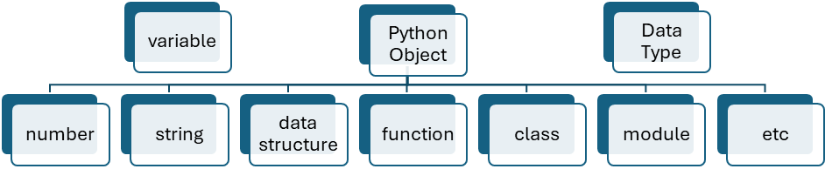
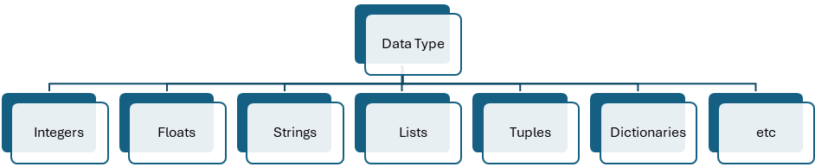
Python Basics
Variables and Data Types
Variables are used to store data.
Python variables are not explicitly typed.
Python data types are associated with the objects that the variables reference

Slide 6
Python Basics
Python numbers
include integers and floats
Integers: whole numbers without decimal points
Floats: numbers with decimal points
the running result is: int_var = 10, float_var = 10.00
int_var = 10
float_var = 9.99999
print(f"int_var = {int_var}, float_var = {float_var:.2f}")

Slide 7
Python Basics
Python Strings
textual data enclosed in single, double, or triple quotes
triple quotes allowing for multi-line strings or docstrings
the running result is:
one_quote_var = hello, world
two_quote_var = hello, world
three_quote_var = hello
world
one_quote_var = 'hello, world'
two_quote_var = "hello, world"
three_quote_var = '''hello
world'''
print(f"one_quote_var = {one_quote_var}\ntwo_quote_var = {two_quote_var}\nthree_quote_var = {three_quote_var}")

Slide 8
Python Basics
Python objects
include collections of elements, such as Lists, Tuples, Dictionaries and Sets

Slide 9
Python Basics
Python Lists
ordered collections of elements and elements
can be any data types
can store heterogeneous collections of data
can be created with brackets, and elements are separated by commas
mutable
Exercise: use other approaches to create var_list, update one item in the list, remove one item from the list
var_list = [10, "hello", 9.99, True, [1, 2, 3], {"language": "Python"}]
print("before add a new item, var_list: ", var_list)
var_list.append(['new', 'item'])
print("after add a new item, var_list: ", var_list)

Slide 10
Python Basics
Python tuples
ordered
Immutable: cannot add new items to them or remove existing ones
can store heterogeneous collections of data
can be created with parentheses (), and elements are separated by commas
Exercise: use other approaches to create var_tuple, output one of the items
var_tuple = (10, "hello", 9.99, True, [1, 2, 3], {"language": "Python"})
print("var_tuple: ", var_tuple)

Slide 11
Python Basics
Python Dictionaries
key-value pairs
keys are unique identifiers, mmutable and hashable
common data types for keys include strings, numbers, or tuples
values can be any data type - numbers, strings, lists, dictionaries, or even custom objects
values store the actual information associated with the key
do not preserve the order in which elements were added
mutable
can be created with curly braces {}, and elements are separated by commas. Colons : separate the keys from their values
Exercise: use other approaches to create apple_stock, remove one key-value pair

Slide 12
Python Basics
Python Dictionaries
# define a dictionary for apple stock
apple_stock = {"symbol": "AAPL", "shares": 100, "price": 150.25, "total_value": 15025.00}
# Accessing values by key
ticker = apple_stock["symbol"]
# Modifying a value
apple_stock["shares"] = 150
# Adding a new key-value pair
apple_stock["year"] = 2023
# get all keys as a list
print("all keys: ", list(apple_stock.keys()))
# get all values as a list
print("all values: ", list(apple_stock.values()))
# get all key-value pairs as tuples of list
print("apple stock: ", list(apple_stock.items()))
# If the key 'going up' exists in the dictionary appleStock, the get() method will return the associated value.
# However, if the key doesn't exist, the get() method will return the second argument, which is 'NaN' (Not a Number) in this case.
print(apple_stock.get('going up', 'NaN'))
# Unlike get(), setdefault() modifies the dictionary if the key doesn't exist.
# the key 'going down' is missing, setdefault() will add it to the dictionary with the value 'NaN'.
apple_stock.setdefault('going down', 'NaN')
print("apple stock: ", list(apple_stock.items()))

Slide 13
Python Basics
Python Sets
unordered collections of unique elements
Elements themselves immutable and hashable
mutable, allow to add or remove elements
can be created with curly braces {}, and elements are separated by commas
Exercise: use other approaches to create var_set, update one item in the list, add a new item, remove one item from the set
var_set = {10, 10, "hello", 9.99, True, (1, 2, 3)}
Print("var_set: ", var_set)

Slide 14
Python Basics
Python Indentation
code blocks are defined by colon(:)
typically using 4 spaces or tabs
determines the scope of loops, conditionals, functions, classes, and other constructs

Slide 15
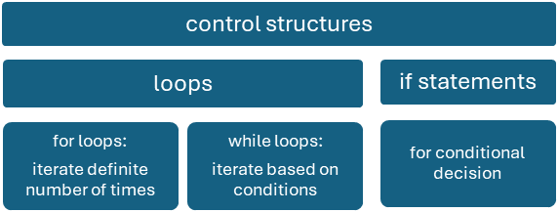
Python Basics
Control Structures

Slide 16
Python Basics
if statement: conditional execution, allowing code to run based on whether a specified condition is true or false

Slide 17
Python Basics
If statement
investment = 1000
current_price = 1155
purchase_price = 1100
if purchase_price == 0:
roi = null
else:
roi = (current_price - purchase_price) / purchase_price * 100
earned = investment * roi / 100
if roi > 10:
print(f"Your investment has a strong return of {roi:.2f}% and you earn {earned: .2f}!")
elif roi > 0:
print(f"Your investment has a positive return of {roi:.2f}% and you earn {earned: .2f}")
elif roi == 0:
print(f"Your investment has broken even and you earn {earned: .2f}.")
else:
print(f"Your investment has a negative return of {abs(roi):.2f}% and you earn {earned: .2f}")

Slide 18
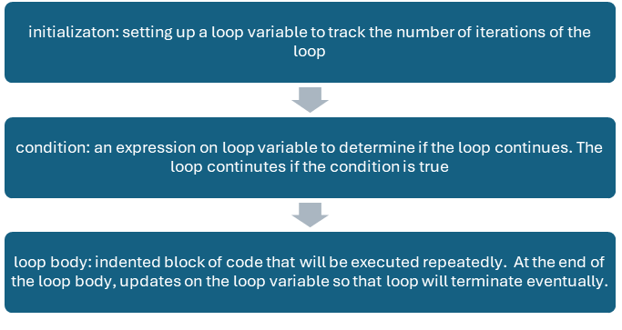
Python Basics
loop: repetitive tasks and/or collections of data

Slide 19
Python Basics
for statement
import random
stock_data = {
"AAPL": round(150.23 + random.random() * 10, 2),
"TSLA": round(900.00 + random.random() * 50, 2),
"GOOG": round(2800.00 - random.random() * 100, 2)
}
for symbol, price in stock_data.items():
print(f"Stock: {symbol}, Price: ${price}")

Slide 20
Python Basics
while statement
aapl_price = 159.23
guess = 180
guess_times = 1 # A counter is initialized to keep track of the number of guesses
while guess != aapl_price:
guess = float(input("Guess apple's stock price: ")) # Prompts the user to guess the stock price and converts the input to a float
if abs(guess - aapl_price) <= 10 and guess_times < 3: # abs(): find absolute value of an expression
print("Congratulations, you guessed the price!")
break # exits the loop
elif abs(guess - aapl_price) > 10 and guess_times < 3:
print("Try again!")
else:
print("Run out of guessing times!")
break # exits the loop
guess_times +=1 # increments the guess counter after each guess

Slide 21
Python Basics
Functions: reusable blocks of code designed to perform specific tasks

Slide 22
Python Basics
function
import yfinance as yf # import yfinance library for stock data
def get_stock_data(symbol): # define function header
try:
stock_data = yf.download(symbol, period="1wk", interval="1d") # download 1-week daily data from Yahoo Finance
except:
print(f"Error: Could not retrieve data for symbol {symbol}.")
return None
current_price = stock_data["Close"].iloc[-1] # get latest closing price
current_volume = stock_data["Volume"].iloc[-1] # get latest volume
return {"Stock ticker": symbol, "Current Price": current_price, "Current Volume": current_volume} # return a dictionary
# passing google, apple and tesla's stock tickers
stock_symbol = ["GOOG", "AAPL", "TSLA"]
for ticker in stock_symbol:
data = get_stock_data(ticker) # data is a dictionary returned from the get_stock_data() function
if data:
for key, value in data.items():
print(f"{key}: {value}")

Slide 23
More on Python
try-except block: prevent potential program crashes

Slide 24
More on Python
Indexing and Slicing
access elements within sequences
indexing: extract a single element using its position
index starting from 0 (zero-based indexing)
use square brackets[] with the index within them to access an element
allows negative indexing to access elements from the end of the sequence: -1 refers to the last element, -2 to the second-last, and so on
Slicing: extract a sub-sequence
use square brackets [] with a start index, an end index, and an optional step (separated by colons): [start:end:step]
The end index in slicing is exclusive
can omit the start or end index in slicing to use the default values. If the step is omitted, the default step is 1

Slide 25
More on Python
indexing and slicing
var_list = [10, "hello", 9.99, True, [1, 2, 3], {"language": "Python"}]
# access first item
print("first item: ", var_list[0])
# access last item
print("last item: ", var_list[-1])
# access the second to the fourth items
print("the second to the fourth items: ", var_list[1: 4])
# use slice assignment to append a list at back or at front, or remove part of a list
var_list[len(var_list):]=['X', 'Y', 'Z']
print("use slice to append at back: ", var_list)
var_list[:0] = ['A', 'B', 'C']
print("use slice to append at front: ", var_list)
var_list[9:-1]=[]
print("use slice to remove: ", var_list)
# use negative step for reversing
print("after reversing: ", var_list[::-1])

Slide 26
More on Python
zip( ) built-in function
creates an iterator that aggregates elements from multiple sequences, and pair them together
tickers = ["GOOG", "TSLA"]
prices = [172, 175]
# Combine tickers and prices into a list of tuples
stocks = list(zip(tickers, prices)) # zip returns an iterator, convert to list
print(stocks)

Slide 27
More on Python
* and ** as function arguments/parameters
* unpacking arguments from iterables (like lists, tuples) into individual arguments for the function
# Unpacking Arguments when used for arguments
def do_unpack(ticker, price):
print(f"Storck Ticker: {ticker}, Price: {price}")
# Call do_unpack with each ticker-price tuple
for stock in stocks:
do_unpack(*stock) # Unpack the tuple into ticker and price arguments

Slide 28
More on Python
* and ** as function arguments/parameters
* catching variable number of arguments: capture any number of arguments passed to the function as a tuple
# Catching variable number of arguments when used for parameters
def sum_all(*numbers):
total = 0
for num in numbers:
total += num
return total
result = sum_all(1, 2, 3, 4, 5)
print(result)

Slide 29
More on Python
** syntax
can be used both in function parameters to accept keyword arguments and in keyword argument unpacking to pass arguments
def unpack_dictionary(**kwargs):
for key, value in kwargs.items():
print(f"{key}: {value}")
# Creating a dictionary
stock_dict = dict(zip(tickers, prices))
# Passing the dictionary to the function using **
# **stock_dict unpacks the key-value pairs of the dictionary, and each pair becomes a separate keyword argument to the function
unpack_dictionary(**stock_dict)

Slide 30
More on Python
Python Comprehensions and Generator Expression
comprehension: build a sequence data structure, such as a list, set, or dictionary, using existing sequences
for tuple comprehension: use the tuple() constructor in combination with a generator expression
generator:
a special type of iterator that supports iteration over a sequence of elements
doesn’t store the entire sequence in memory but generates one element at a time on demand
memory-efficient and capable of handling even infinite sequences

Slide 31
More on Python
Python Comprehensions and Generator Expression

Slide 32
More on Python
Python Comprehensions and Generator Expression
var_list = ['A', 'B', 'C', 10, 'hello', 'hello', 'hello', 9.99, True, [1, 2, 3], {'language': 'Python'}, 'X', 'Y', 'Z']
# build a list comprehension from an existing list's string elements
comp_list = [var for var in var_list if isinstance(var, str)]
print(comp_list)
# build a set comprehension from an existing list's string elements
comp_set = {var for var in var_list if isinstance(var, str)}
print(comp_set)
# build a dictionary comprehension from two existing lists
stock_symbol = ["GOOG", "AAPL", "TSLA"]
stock_price = [172, 190, 175]
stocks_share = {symbol:price for symbol, price in zip(stock_symbol, stock_price)}
print(stocks_share)
# build a generator comprehension from an existing list's string elements
comp_generator = (var for var in var_list if isinstance(var, str))
print(comp_generator)
for var in comp_generator:
print(var, end = ' ')
print()
# build a tuple using generator comprehension
comp_to_tuple = tuple(var for var in var_list if isinstance(var, str))
print(comp_to_tuple)

Slide 33
More on Python
Lambda Expressions
functions: have a header containing the function name and a list of parameters
lambda expressions are simple, anonymous functions that can be defined and used inline
# two lambda expressions are used to do calculations between feet and meter conversion
width = {'Feet to Meter': lambda feet: 0.305 * feet,
'Meter to Feet': lambda meet: 3.281 * meter}
print(width['Feet to Meter'](3.9))

